Slide 1
Introduction to Film Studies
Week 2
Narrative structures
Nicholas YB Wong
Department of English, HKIEd

Slide 2
Jonas Mekas, Village Voice (Nov 25 1959)
There is no doubt that most of the dullness of our movies is concocted in advance, in the so-called heads of the so-called scriptwriters. Not only the dullness. They also perpetuate the standard film constructions, dialogues, plots. They follow closely their textbooks of “good” screenwriting. Shoot all scriptwriters, and we may yet have a rebirth of American cinema.

Slide 3
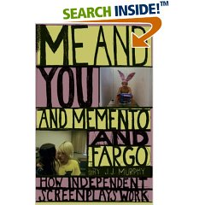
Suggested reading
J.J. Murphy. 2007. Me and You and Memento and Fargo: How Independent Screenplays Work. New York and London: Continuum.

Slide 4
Independent Channels
Website: http://www.indieWIRE.com
TV channels: Sundance, Independent Film Channel
Theatres: Landmark, Film Forum, IFC
Film Festivals: Sundance, Slamdance
Film publications: Filmmaker, The Independent
Distributors: Miramax, Focus Features, Sony Pictures Classics, Fox Searchlight

Slide 5
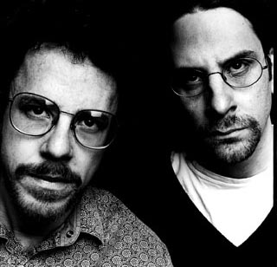
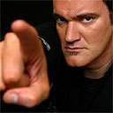
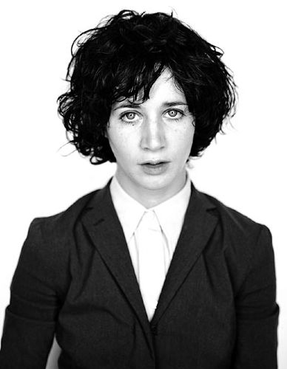
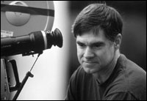
Independent Writers/Directors
Jim Jarmusch
Todd Haynes
Quentin Tarantino
David Lynch
Kimberly Pierce
Gus Van Sant
Coen Brothers
Miranda July

Slide 6
What makes them ‘independent’?
Budget?
Aesthetic qualities?
“a word… created outside the dominant Hollywood system.” (2)
Christine Vachon: “While it’s true that, in the best of all possible worlds, independent films are genuinely alternative visions, there’s no such thing as an absolutely independent film. There’s still economy at work: The movie has to go to the marketplace, and people have to want to see it.”
Audience as the centre of concern
“Independent films are closer in spirit to the international art film in the sense that they are products of a personal vision either ignored or at odds with the studio system.” (4)

Slide 7
Structure
“a distinctive approach to filmmaking, centering on new conceptions of cinematic storytelling.” (6)
‘three-act paradigm’
“The independent filmmaker is usually aware of the rules but treats them as flexible guidelines, to be used as necessary but also to be rejected or reworked if it will yield a creative benefit.”
Freytag’s Pyramid

Slide 8
Three-act Paradigm
Syd Field’s Screenplay
Screenplay: one page = one min
Comedy shorter
Average length: 120 pages
Beginning (setup):
establish characters and story
First 10 mins are the most important because “you’ve got to hook your reader immediately”.
Middle (confrontation)
Hurdles and obstacles
Ending (resolution)
Resolve dramatic conflicts

Slide 9
The Plot Point
1st and 3rd acts are 30 pages long
2nd act is 60 pages
Plot point as hinges
PP: “turn the story in a different direction and usually occur at precise moments between each act.” (7)
1st PP: pp.25-27
2nd PP: pp. 85-90

Slide 10
David Bordwell
“the art cinema defines itself explicitly against the classical narrative mode, and especially against the cause-effect linkage of events.”
Characters “lack clear-cut traits, motives, and goals.”
Narratives tend to be more ambiguous and open-ended.
“Whereas classical narration attempts to create and maintain a seamless illusion in the telling of the story, art cinema creates inexplicable gaps and problems, which often make us keenly aware of the mediating presence of the author.”

Slide 11
Independent Films
Hybrid
Different from the mainstream films in terms of “story concept, structure, character, dialogue, visual storytelling, representation, and overall narrative strategy…” (16)
Usually short scripts (< 120 mins) → cut cost
No clear midpoint
Temporality and causality

Slide 12
Single Protagonists
Some have clear single protagonists
Multiple protagonists and multiple plotlines (ensemble film)
Character arc (transformation of characters)
Romance?
Antagonists (creating conflicts)
“In independent films, character motivation is often buried, which reflects a desire to create characters that are less heroic figures than people we find in real life.” (22)
Classical Hollywood as plot-centred
Independent films as character-centred → dialogues (more everyday life and long-winded)
Interior monologues (“dialogues of the deaf”, Sarah Kozloff)

Slide 13
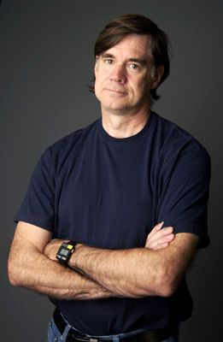
Gus Van Sant
Milk (2008)
Paranoid Park (2007)
Last Days (2005)
Elephant (2003)
Gerry (2002)
Finding Forrester (2000)
Psycho (1998)
Good Will Hunting (1997)
To Die For (1995)
Even Cowgirls Get the Blues (1993)
My Own Private Idaho (1991)
Drugstore Cowboy (1989) (as Gus Van Sant Jr.)
Mala Noche (1985)

Slide 14
Freedom and Scripts
Screenwriter Magazine
For me, the screenplay’s always been something that you work on in private, and then you use that on the set. You basically copy it. You transfer it, and in that transferring period, you’re very busy interpreting the actual screenplay and there’s not a lot of room for extra stuff – the fun stuff – that’s outside the screenplay. So when I got rid of the screenplay, I found there was only the fun stuff. (163)

Slide 15
Style
Ordinary conversations and scripted conversations
Elimination of scripted dialogues allows flexibility
Eastern European art-cinema
Long takes
Intricate camera movements
Béla Tarr
“Van Sant uses extended tracking shots to follow his teenage characters as they traverse (橫渡) the seemingly endless and intersecting corridors of a suburban high school.” (163)

Slide 16
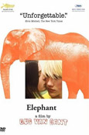
Elephant (2003)
Columbine shootings on April 20 1999
Abandoned the script
Non-professional Portland teenage cast
Free to improvise the dialogues
Collapse the boundary between actor and role

Slide 17
Opening Scenes
Fixed shot on the sky (from daylight to darkness)
John and the drunken father
Foreshadows sudden chaos and unexpected horror
John as the “pivotal character” of the “web-of-life plot” or “network narrative”
Temporal structure
Moving backward and forward
“Cubist sense of the simultaneity of various events in the process” (166)

Slide 18
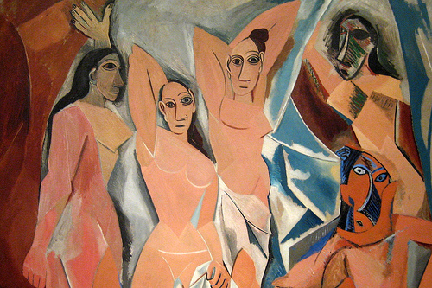
NYC - MoMA: Pablo Picasso's Les Demoiselles d'Avignon

Slide 19
Structure in Elephant
Around 100 shots in the entire film
“the pace of the film accelerates dramatically in the third act” (174)
Alex and Eric: why the violence? (blurred motives)
Moves from nothing to something
“Elephant’s loaded subject matter almost guarantees the viewer that there will be a significant dramatic payoff. The last segment fulfills that promise, as the film shifts from being nonlinear to linear… The extremely slow buildup, in fact, only heighten viewer expectation…” (175)

Slide 20
Ambiguities
“What Van Sant gives us in the film… is not necessarily true portrait of the actual Columbine killers, but rather fictional representation of them as they were portrayed by the media.” (177)
Van Sant: “It has elements of Columbine. But we never really tried to get at who these people were. We sort of invented our own.”
Elephant – allusion (the five blind men and the elephant)
Wall, rope, tree, a snake – What an elephant is is an “unanswerable question”.

Slide 21
Visual and Verbal
visual > verbal information
Minimizing the amount of dialogues
“This allows viewers an even greater freedom to contemplate and speculate about the events that are occurring.” (179)
Criticism: couldn’t provide answers about the Columbine shooting
“The way I thought the film is supposed to work is that it leaves a space for you to bring to mind everything you know about the event. It doesn’t give you an answer. There’s no one-stop solution. And if you think there’s an answer you can isolate – maybe it’s video games, maybe it’s the parents – then that lets you think that the problem is somewhere else and that you aren’t part of it. And that’s a mistake, because we all are part of it.”
Rejecting the easy answers in classical cinema.

Slide 22
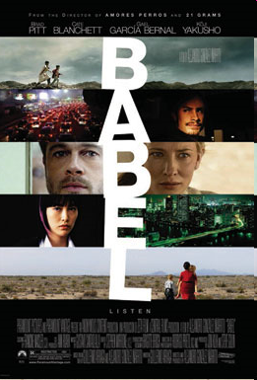
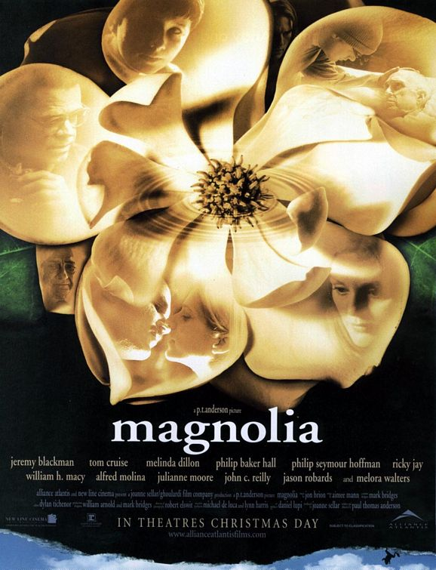
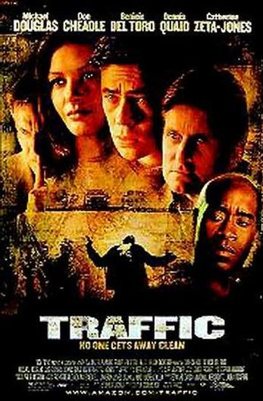
Ensemble Films
Robert Altman’s Nashville (1975)
Steven Soderbergh’s Traffic (2000)
Paul Thomas Anderson’s Magnolia (1999)
Alejandro González Iñárritu’s Babel (2004)
Paul Haggis’s Crash (2005)

Slide 23
Editing
How to paste the multiple narratives together?
“ensemble films share formal and stylistic elements like rapid cross-cutting or ‘short cuts’, a propensity for montage and continual camera motion, scenes choreographed to music, and the use of rhyming visual threads and graphic matches – most often cuts between different characters driving cars or walking through doors to different buildings – to connect disparate sequences.”
Hsuan L. Hsu. 2006. “Racial Privacy, the L.A. Ensemble Film, and Paul Haggis’s Crash” in Film Criticism 31 no 1 / 2. (Fall/Winter 2006). pp. 132-56.

Slide 24
Urban Life
The loneliness and hollowness of city dwellers
Raymond Williams, “The Metropolis and the Emergence of Modernism” (1985)
William Wordsworth’s poems reads:
The present, and the past; hope and fear; all stays
All laws of acting, thinking, speaking man
Went from me, neither knowing me, nor known.
(quoted from Williams, 1985: 85)

Slide 25
Ensemble Film and Loneliness
George Simmel. “The Metropolis and Mental Life”
“Ensemble films appeal to… fears and fantasies: most of their individual characters and suburban couples share a sense of urban or suburban isolation, but the camera exposes or at least intimate connections even when characters feel most alienated.”

Slide 26
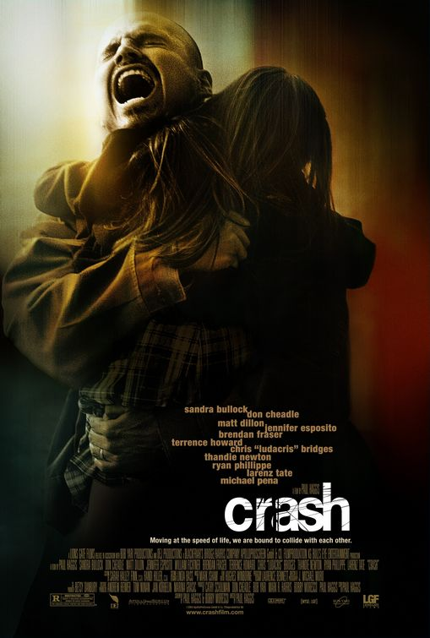
Crash (2005)
Paul Haggis
Best Motion in Oscar
“It’s the sense of touch. In any real city, you walk, you know? You brush past people, people bump into you. In L.A. nobody touches you. We’re always behind this metal and glass. I think we miss that touch so much, that we crash into each other, just so we can feel something.”
“It focuses the film on interpersonal relationships and the ways in which individuals can… change their racial attitudes and racist practices…” (Hsuan, 144)

Slide 27
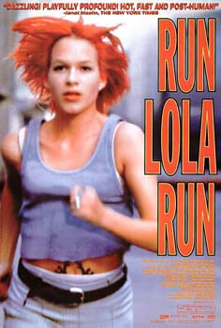
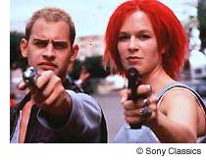
Running in Circles
Tom Tykwer
“how the story is communicated, not just what happens in it – is essential to how it works and the resulting audience experience”

Slide 28
Form and Content
David Bordwell and Kristin Thompson:
“Very often people assume that ‘form’ as a concept is the opposite of something called ‘content’. This assumption applies that a poem or a musical piece of a film is like a jug: an external shape, the jug contains something that could just as easily be held in a cup or pail. Under this assumption, form becomes less important than whatever it is presumed to contain. We do not accept this assumption…”
Style and Story
Narrative form: characters, events and plot
Stylistic elements: sound, editing, cinematography
Inseparable
Run Lola Run: “its form is its story”

Slide 29
Multiform Plot
The treatment of time
Circularity, the idea of cycling
The action of undoing
Interactive works and video games
“changes have a big impact, setting off different ‘domino chains’ of incidental moments” (155)
Not just a story about whether Lola can get the money
Also about how “coincidence, chance and seemingly random encounters influence her fate”

Slide 30
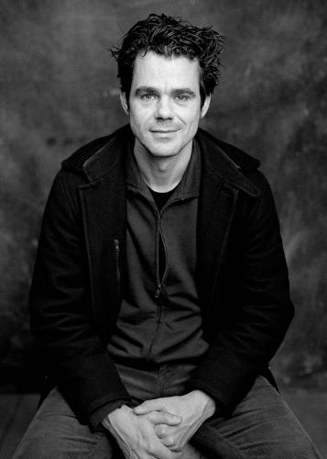
Tykwer and Chances
“Everything is influenced by the smallest situation. It’s a very controversial thought. If everything is important. But on the other hand, I don’t believe that. You have to challenge coincidence, and there is a path to take. All odds are against Lola, and at the end, it shows that she changes her fate, it’s really her passionate, possessive desire to change the system she is stuck in. And the system is time.” (156)
Reflecting contemporary urban lifestyle?

Slide 31
Beginning Footage (Pre-credits)
“The camera tracks through a mass of people, occasionally setting on characters later revealed as our ‘incidental’ players, to finally reach the security guard… who says, ‘The ball is round. The game lasts ninety minutes. All else is pure theory’ as he tosses a soccer ball into the air.”
Soccer as a metaphor
Anything could happen
Lola’s ball game – getting the money

Slide 32
Three-act Paradigm?
Seemingly contradictory
Clear setup
Not one middle and ending
But three of each
Features of classical cinematic narrative present:
Disruption or problem (Lola is troubled)
Running in the street → introduced to different characters
Having a defined goal, there is a trigger
Development evolves around the goal
A sense of causality
Tywker: “new from the outside”

Slide 33
Editing
Between intervals: editing is used to condense and expand time
Not to match reality, but to create emphasis, tension and contrast in the story.
When Lola runs, the film might cut from her running in Location A to her running in Location B. There is a condensation of time.
Slow motion to add emphasis
Fast edits to quicken the rhythm and speed.

Slide 34
Music
Helps quicken the pace
Encounter strangers, music drops back a bit
Urgency
Emotional level
Desperate music
How Lola feels

Slide 35
Visual Media
Flashbacks in B&W
Still images
Animation
Lola and Manni, shot in 35mm film
Without them, shot in video
Visually richer when the protagonists are present
A contrast between them and the rest of the world
More real, more vivid and intense (158)

Slide 36
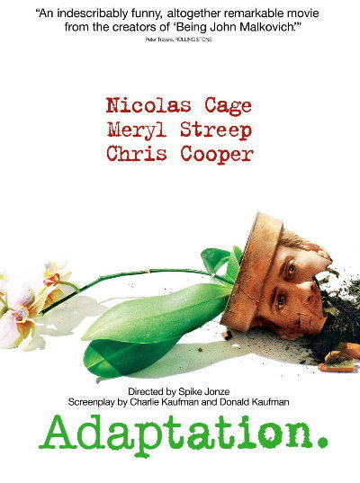
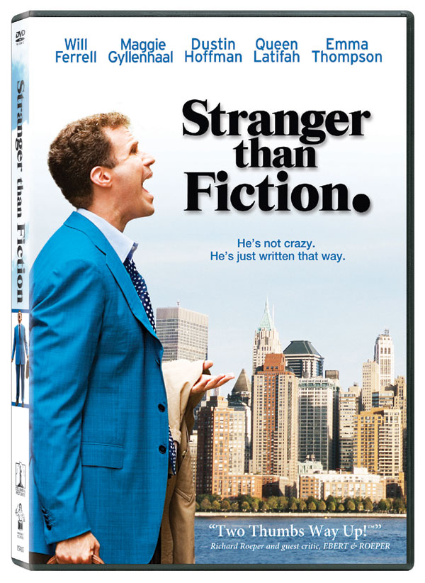
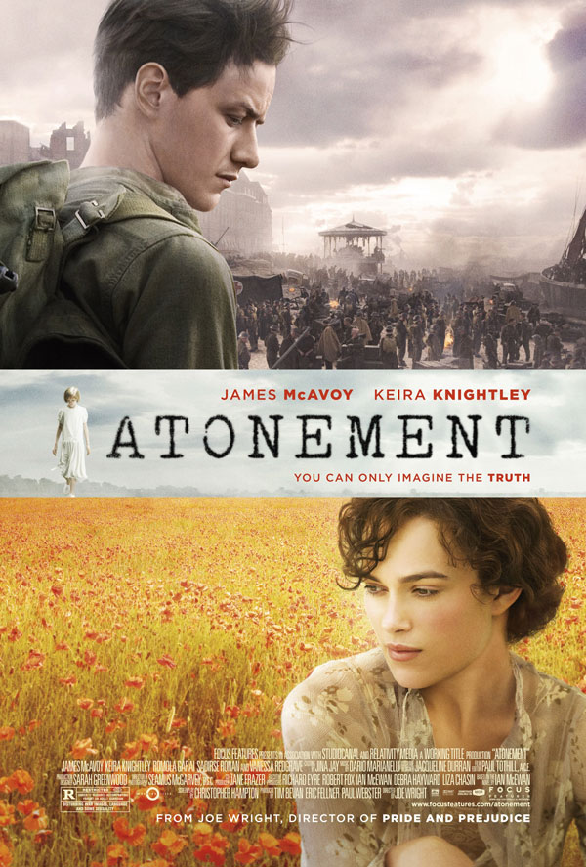
Meta-narrative
Meta – above
Narrative above narrative
Metafiction – fiction conscious of the making of fiction / fiction about writing fiction
E.g. Adaptation and Stranger than Fiction, Atonement
More info at: http://en.wikipedia.org/wiki/Metanarrative

Slide 37
Slumdog Millionaire
Based on the novel Q&A by Vikas Swarup (2005)
“Jamal Malik… ascends from the slums to triumph on Who Wants to be a Millionaire? Because his crushing past has provided him with all the right answers on the quiz show.” (34)
The heavy use of flashbacks in the film.
J.M. Tyree. 2009. “Against the Clock: Slumdog Millionaire and The Curious Case of Benjamin Button” in Film Quarterly, vol. 62 no. 4, pp. 34-8.

Slide 38
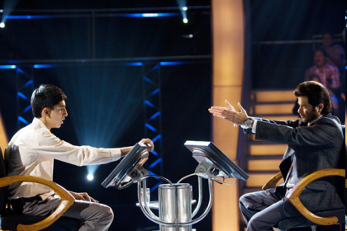
Time & memory in Slumdog
“In Slumdog Millionaire teleology [the doctrine that final causes exist] rules: events are patterned in an orderly trajectory, and time is on the side of the protagonist. Cinema audiences everywhere are now gladdened by the convenience that during the course of the film Jamal learns the answers to the quiz show questions in the same order as his own life experiences, making the telling of his own life story sequentially parallel with the unfolding drama of the television show” (35).
The narrative of Jamal’s life
The narrative of the quiz show

Slide 39
The success of the film?
A global epic
Epic: long narrative poetry (from Greece) about heroic acts
Global: Who is the icon on the US$100 bill?
“… it depicts the horror of slum girls bred for underage prostitution and beggar children blinded by their owners for retail display. And there is quasi-documentary footage here of real locations and real misery mixed up with this fairy tale: people bathing in trash-strewn rivers… a sequence of multiplying rooftops showing the vast scale of a Mumbai slum. SM wants to have it both ways by allowing images of actual horror to seep into a Bollywood-like dream and then letting us off the hook by suggesting not only that true love conquers all, but that personal decency might well result in a multimillion-dollar payday” (35).

Slide 40
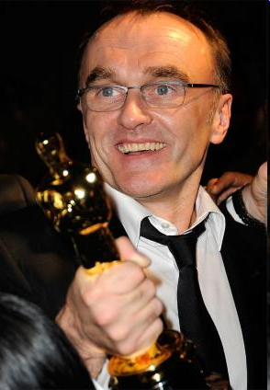
“Bolye wants to break the glass from time to time so that the film doesn’t become saccharine (sweet) and so that his audience can’t derive false comfort from its ‘rags-to-raja’ tale. But by doing so he creates cracks in the picture that can’t be fixed by seeing its young actors frolicking at Disneyland and on the Oscar-night red carpet. There is a contradiction between what the film tells us about the universe operates and what it shows us about abject poverty”.
Rags – a worthless piece of cloth
Raja – a king/prince in India

